Slide 1

Presentation on “CSE Premier League System”
DEPARTMENT OF COMPUTER SCIENCE & ENGINEERING
Supervised by: Presented by:
Md. Kamrul Hassan Majumdar Md. Zahidur Rahman
Lecturer, Md. Al Amin Feroz
Department of CSE Md. Humayun Kabir
Comilla University

Slide 2
Outlines
Existing System
Proposed System
Feasibility study
Software requirements
Implementation & Testing
Future Work

Slide 3
Existing System
The existing premier league system uses paper based system to keep information which is slow and old process .
This system relies heavily on the actions of people which increase the possibility of human-made error.
Difficult to update concurrently.
Security problems.

Slide 4
Proposed System
Our proposed system will have the following advantages:
User friendly interface
Provide features for both Cricket and Football
Provide run rate and goal difference in points table
Fast access to database
Less error
All the manual difficulties in managing the information have been rectified by implementing computerization.

Slide 5
Analysis Model
In this model, the sequence of activities performed are: -
• Feasibility study
• Requirement Analysis • Project Planning • System design • Detail design • Coding • Testing

Slide 6
Feasibility Study
The main objective of the feasibility study is to test the Technical and Economical feasibility.
Technical: Since the project is designed with Eclipse with Java as Front end and MySQL Server as Back end, it is easy to install in all the systems wherever needed. Hence this project has good technical feasibility.
Economical: Since Java with Eclipse and MySQL is more commonly available and cost involved in the installation process is not high. Hence this project has good economical feasibility.

Slide 7
Software requirements
Operating System : - Microsoft Windows 7,8,10
Data Base Server: MySQL
Front-End: Eclipse, Java Swing, JDK
Back-End: MySQL

Slide 8
Implementation & Testing
Here, we will see how our system works through implementing number of forms.
Lets see…

Slide 9

Coverpage

Slide 10
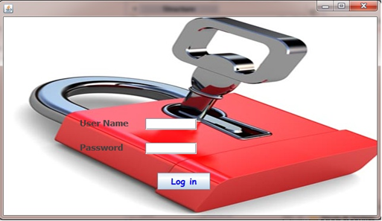
Login

Slide 11
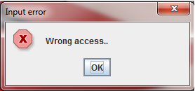
Login
When the wrong user name and password are entered by the user the following message will be shown. Otherwise, enter to the next frame.

Slide 12
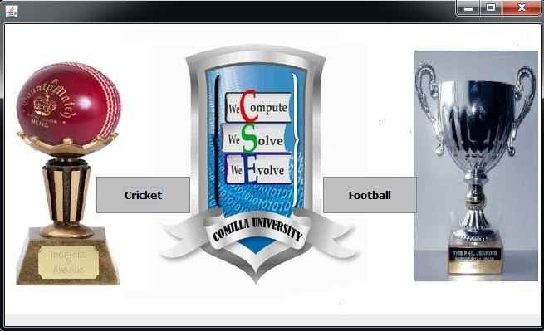
Select

Slide 13
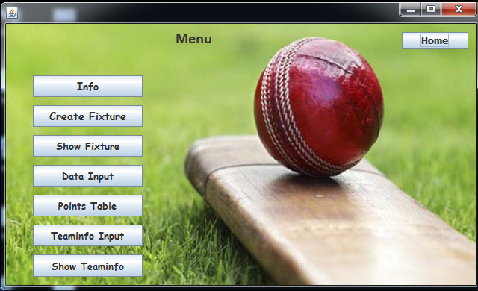
Menu

Slide 14
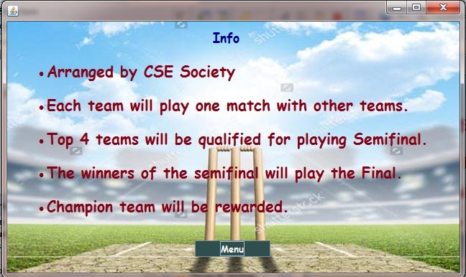
Info

Slide 15
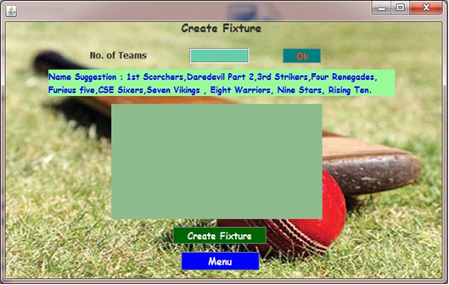
Create Fixture

Slide 16
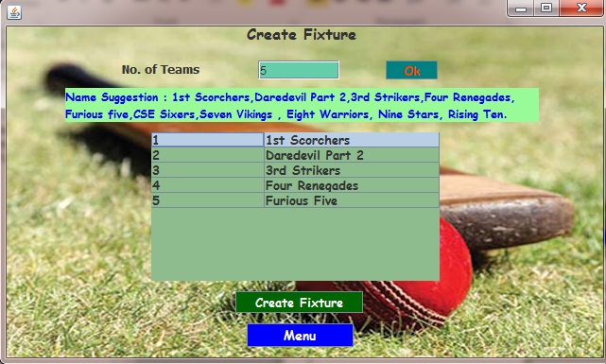
Create Fixture

Slide 17
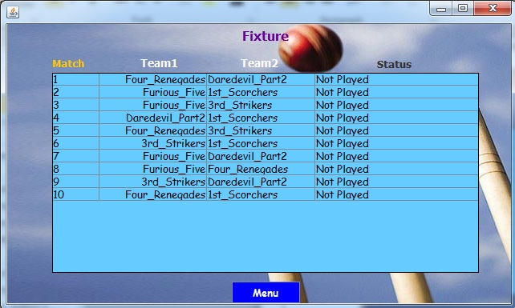
Show Fixture

Slide 18
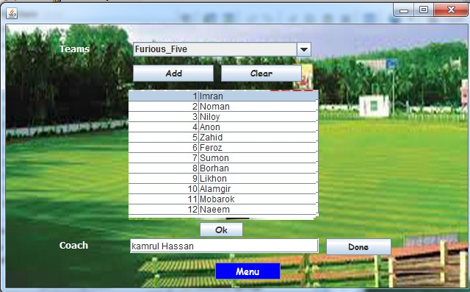
Team Info

Slide 19
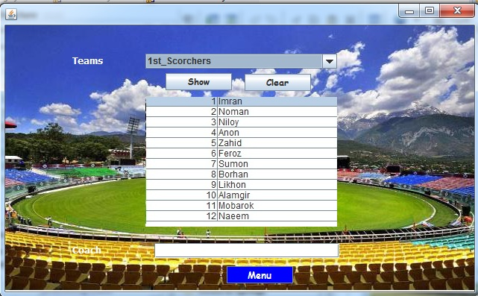
Show Team Info

Slide 20
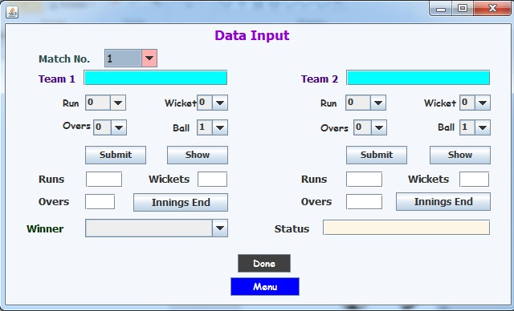
Data Input

Slide 21
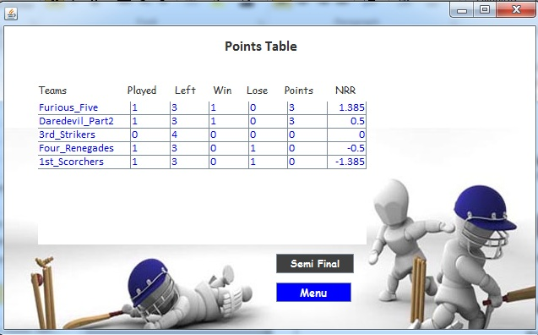
Points Table

Slide 22
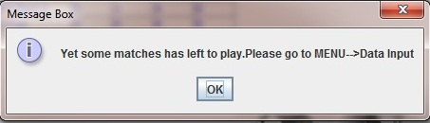
Points Table
If all matches are not played and we press “Semi Final” button then following message will be shown .

Slide 23
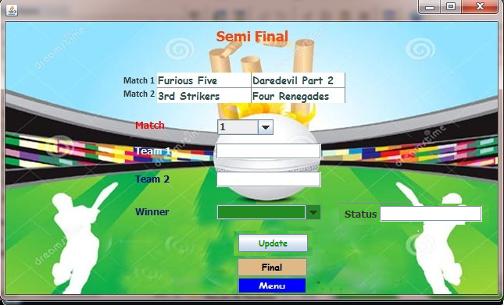
Semi Final

Slide 24
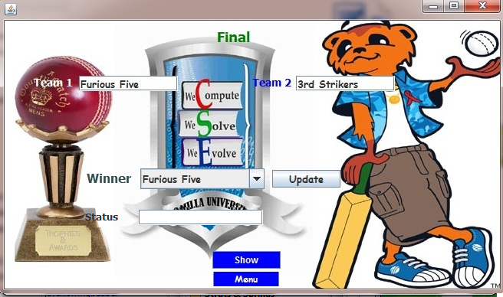
Final

Slide 25
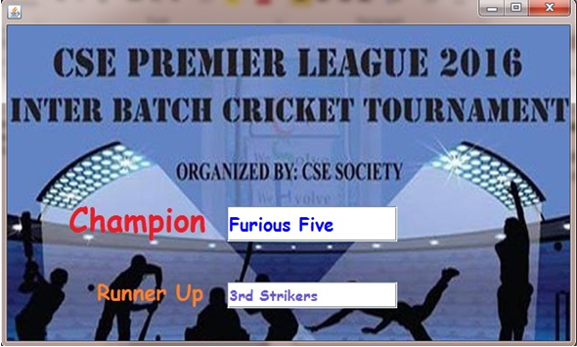
Show Winner

Slide 26
Select

Slide 27
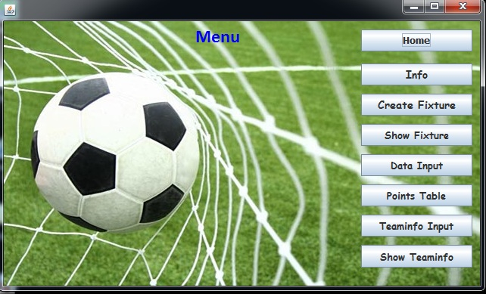
Menu

Slide 28
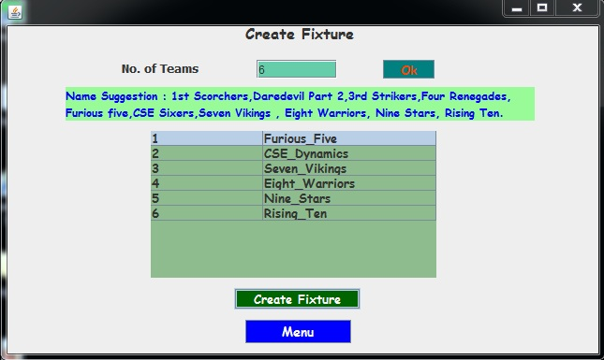
Fixture

Slide 29
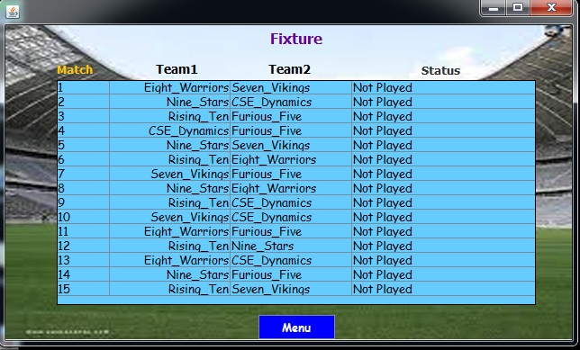
Show Fixture

Slide 30
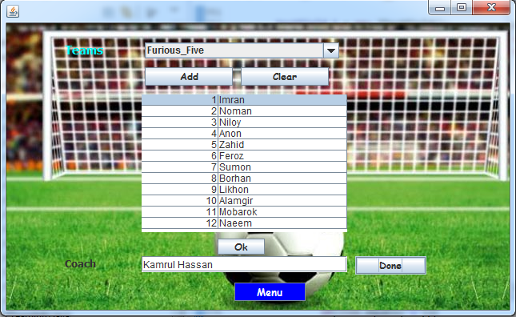
Team Info

Slide 31
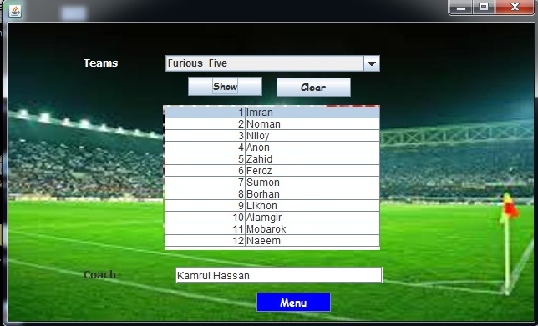
Show Team Info

Slide 32
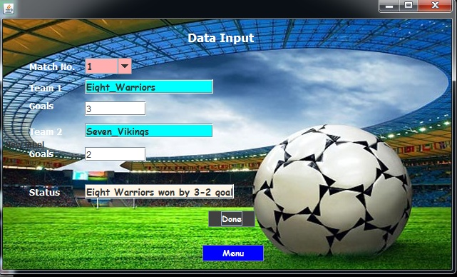
Data Input

Slide 33
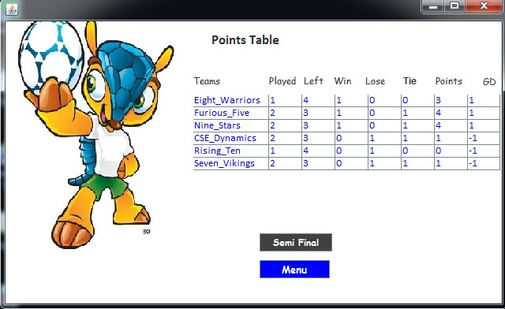
Points table

Slide 34
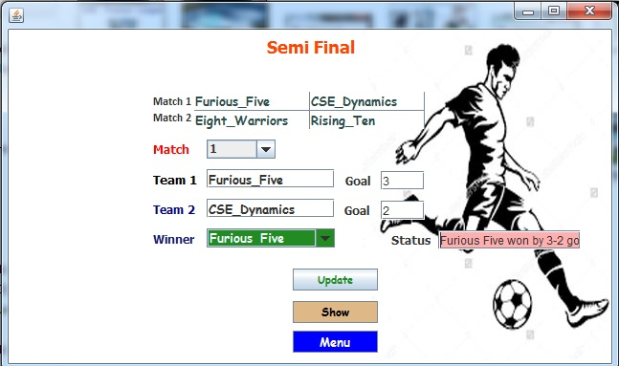
Semi Final

Slide 35
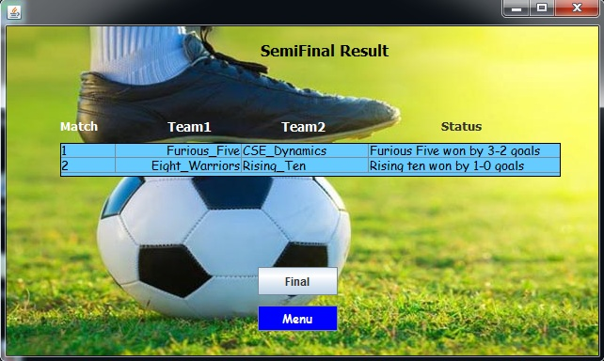
Semi Final Result

Slide 36
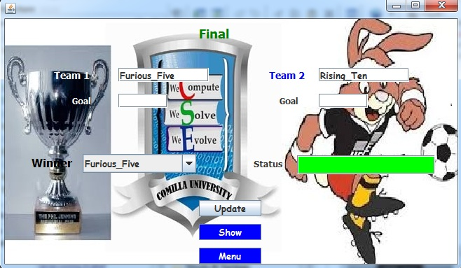
Final

Slide 37
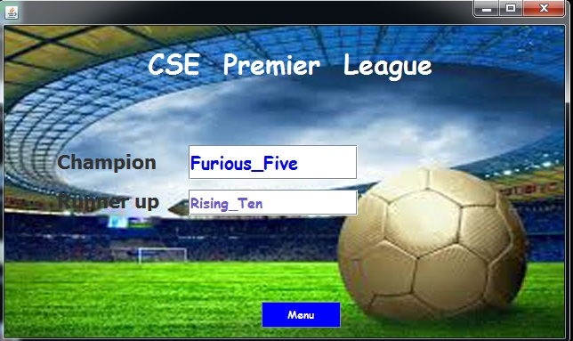
Show Winner

Slide 38
Future Work
We are interested to add more features which make the project more convenient to its users
We are also interested to make the android version of this project.

Slide 39
Thanks all for watching this presentation with patience

